Slide 1
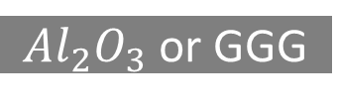
Cr/Au
Ru
Ta
Cr/Au
CoFeB
Ru
MgO
Ta
CoFeB
CoFeB
CoFeB
$Al_{2}O_{3}$ or GGG
MgO
MgO
FeGa
FeGa
FeGa
FeGa
PMN-PT
PMN-PT
PMN-PT
PMN-PT
PMN-PT
Kapton
Kapton
Kapton
Kapton
Kapton
Thin-film 1
Thin-film 2
Thin-film 3
Thin-film 4
Thin-film 5

Slide 2


Circular nanostructures
Elliptical nanostructures

Slide 3
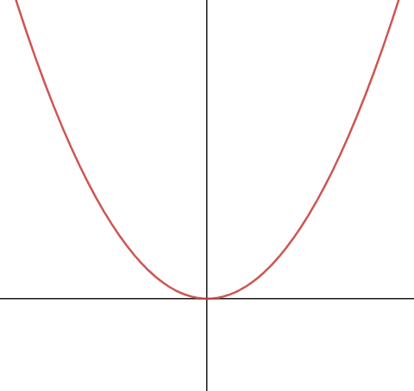

ERROR
← Initial Point
K
(Optimizing parameter)

Slide 4



$$θ_{i}<θ_{c}$$
$$θ_{i}=θ_{c}$$
$$θ_{i}>θ_{c}$$

Slide 5
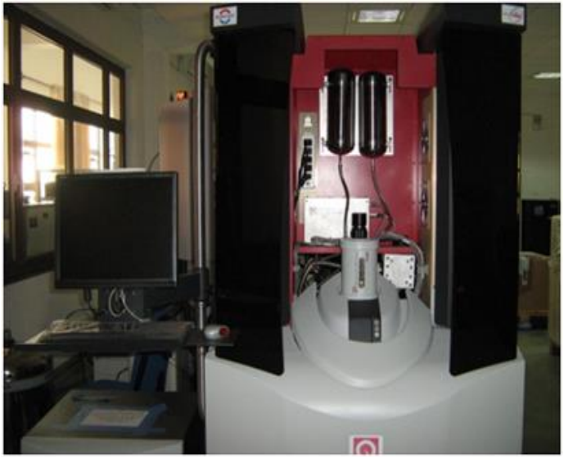
VSM (Vibrating Sample Magnetometer)
H field
Pick up coil
Sample position
transformer
SQUID with electronics
M Mohanlal Naik
IISER Bhopal
5

Slide 6
Laser source
Photo detector
Flexible cantilever
Magnetic tip
Sample

Slide 7
Laser source
Photo detector
Flexible cantilever
tip
Sample

Slide 8
X-ray source
X-ray detector
Normal to surface
Incident X-ray
Reflected X-ray
Sample

